Slide 1




St Paul’s School: Cyclone

Slide 2
The proposal
Primary mission:
Secondary mission:
Air Temperature
Pressure
Data transmission to base station
Quadcopter:
Deploys from launch
Within specified CanSat dimensions
Ability to explore unknown landscapes
Autonomous/Manual Control (GPS, acceleration)
Agricultural Viability
Using predefined algorithm to estimate how suitable a given area would be for crop cultivation (primary obj. + R_{H})

Slide 3

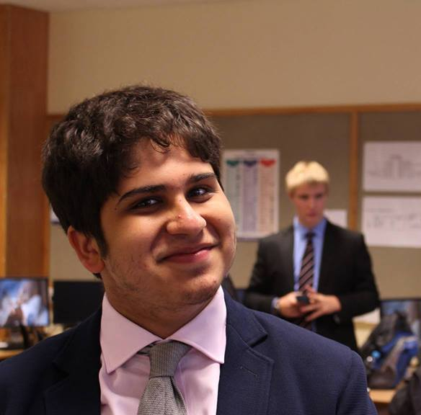
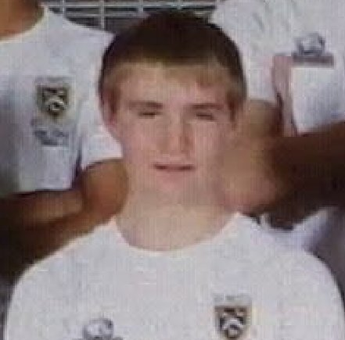

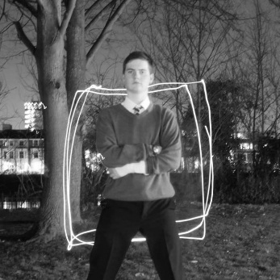

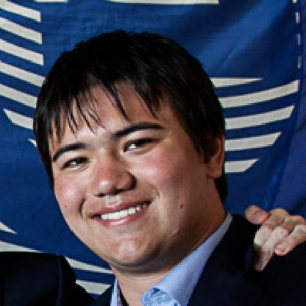
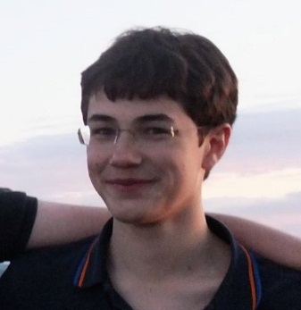
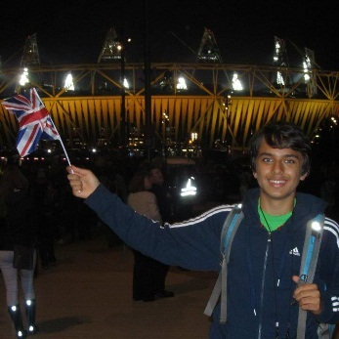
THE TEAM
BENJAMIN YASS
Head of Structural Design
NICHOLAS PALMER
Material & Construction
DANIEL HALSTEAD Flight Control
ASHWIN AHUJA
Head of Software/ Electrical Design
HUGO AARONSON
Data Analysis
WILLIAM EUSTACE
Base Station Software
Structural Design
Software & Electronics
Outreach
JAMES CROMPTON
Communication Systems
QUENTIN GUÉROULT
Head of Outreach
PHILIP FERNANDES
Agricultural Viability

Slide 4
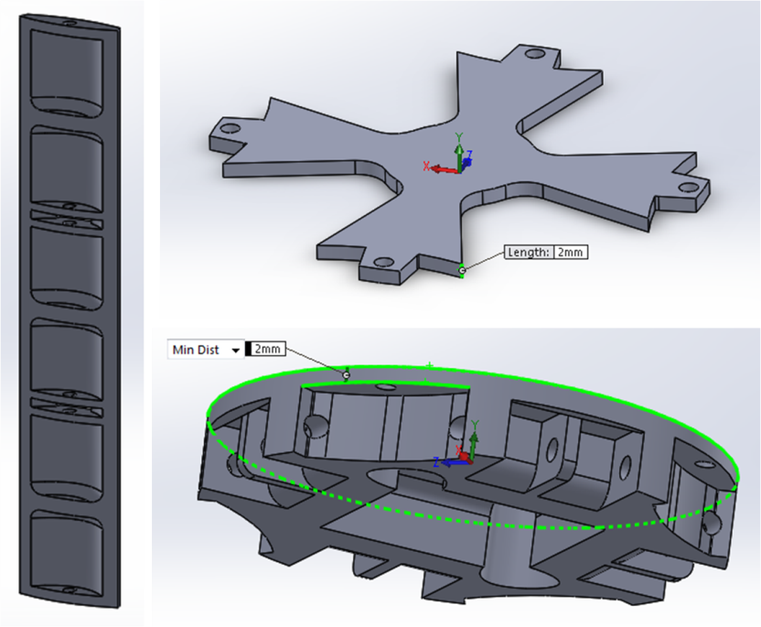
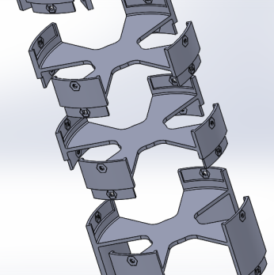
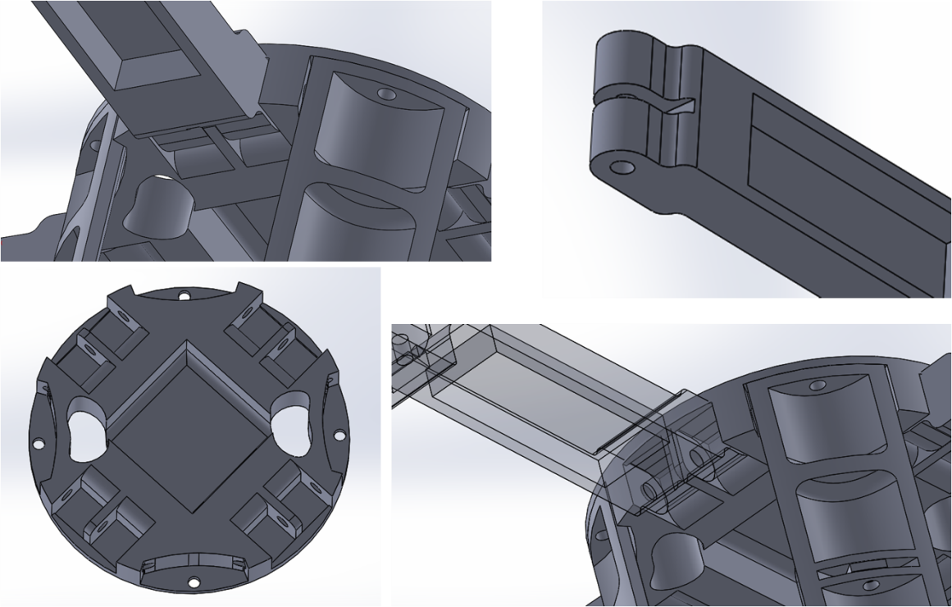
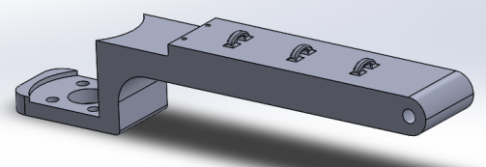
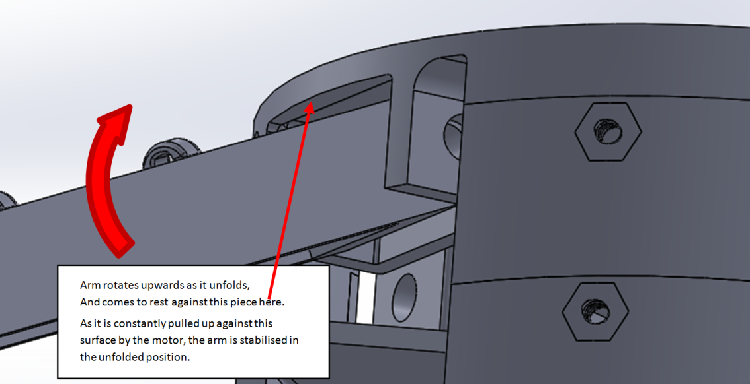
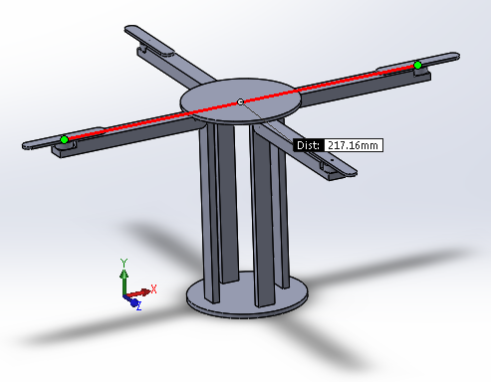
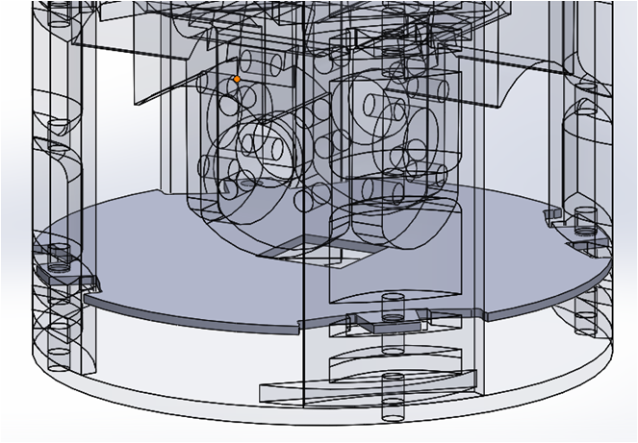
Mechanics

Slide 5
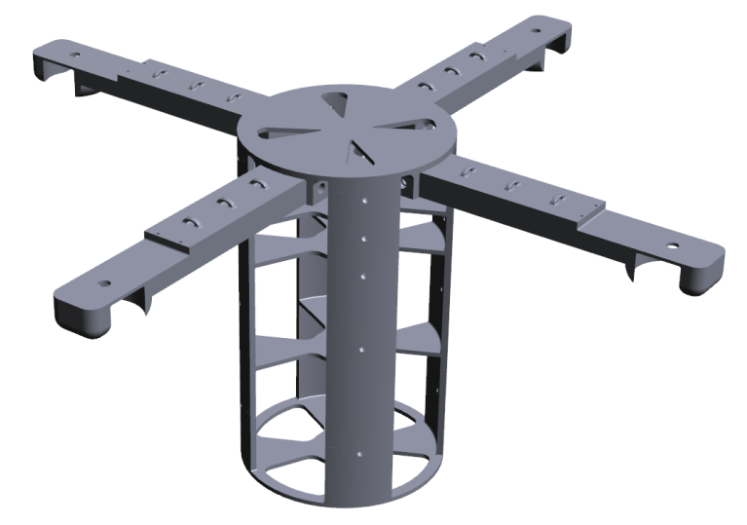
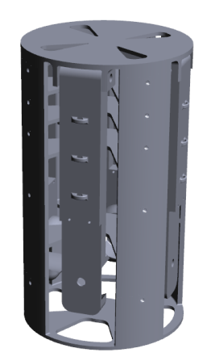
http://teamcycl.one/finalinterimreport

Slide 6
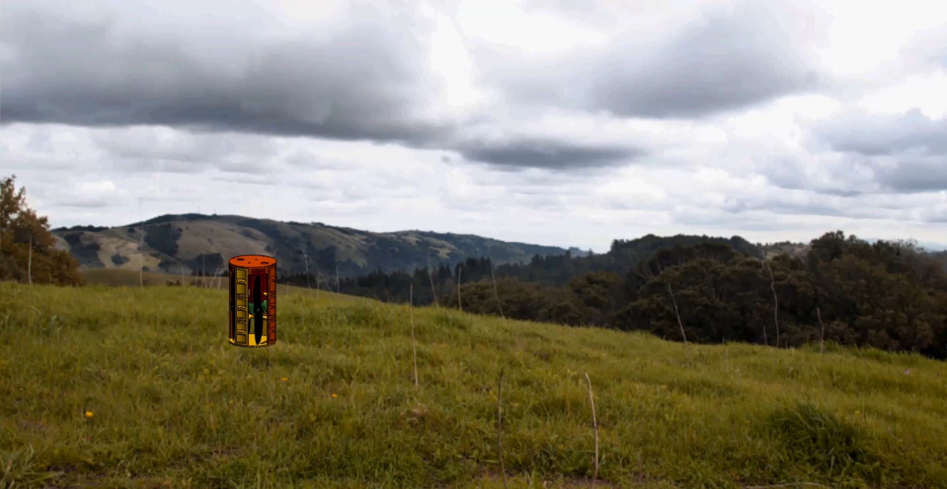

Slide 7
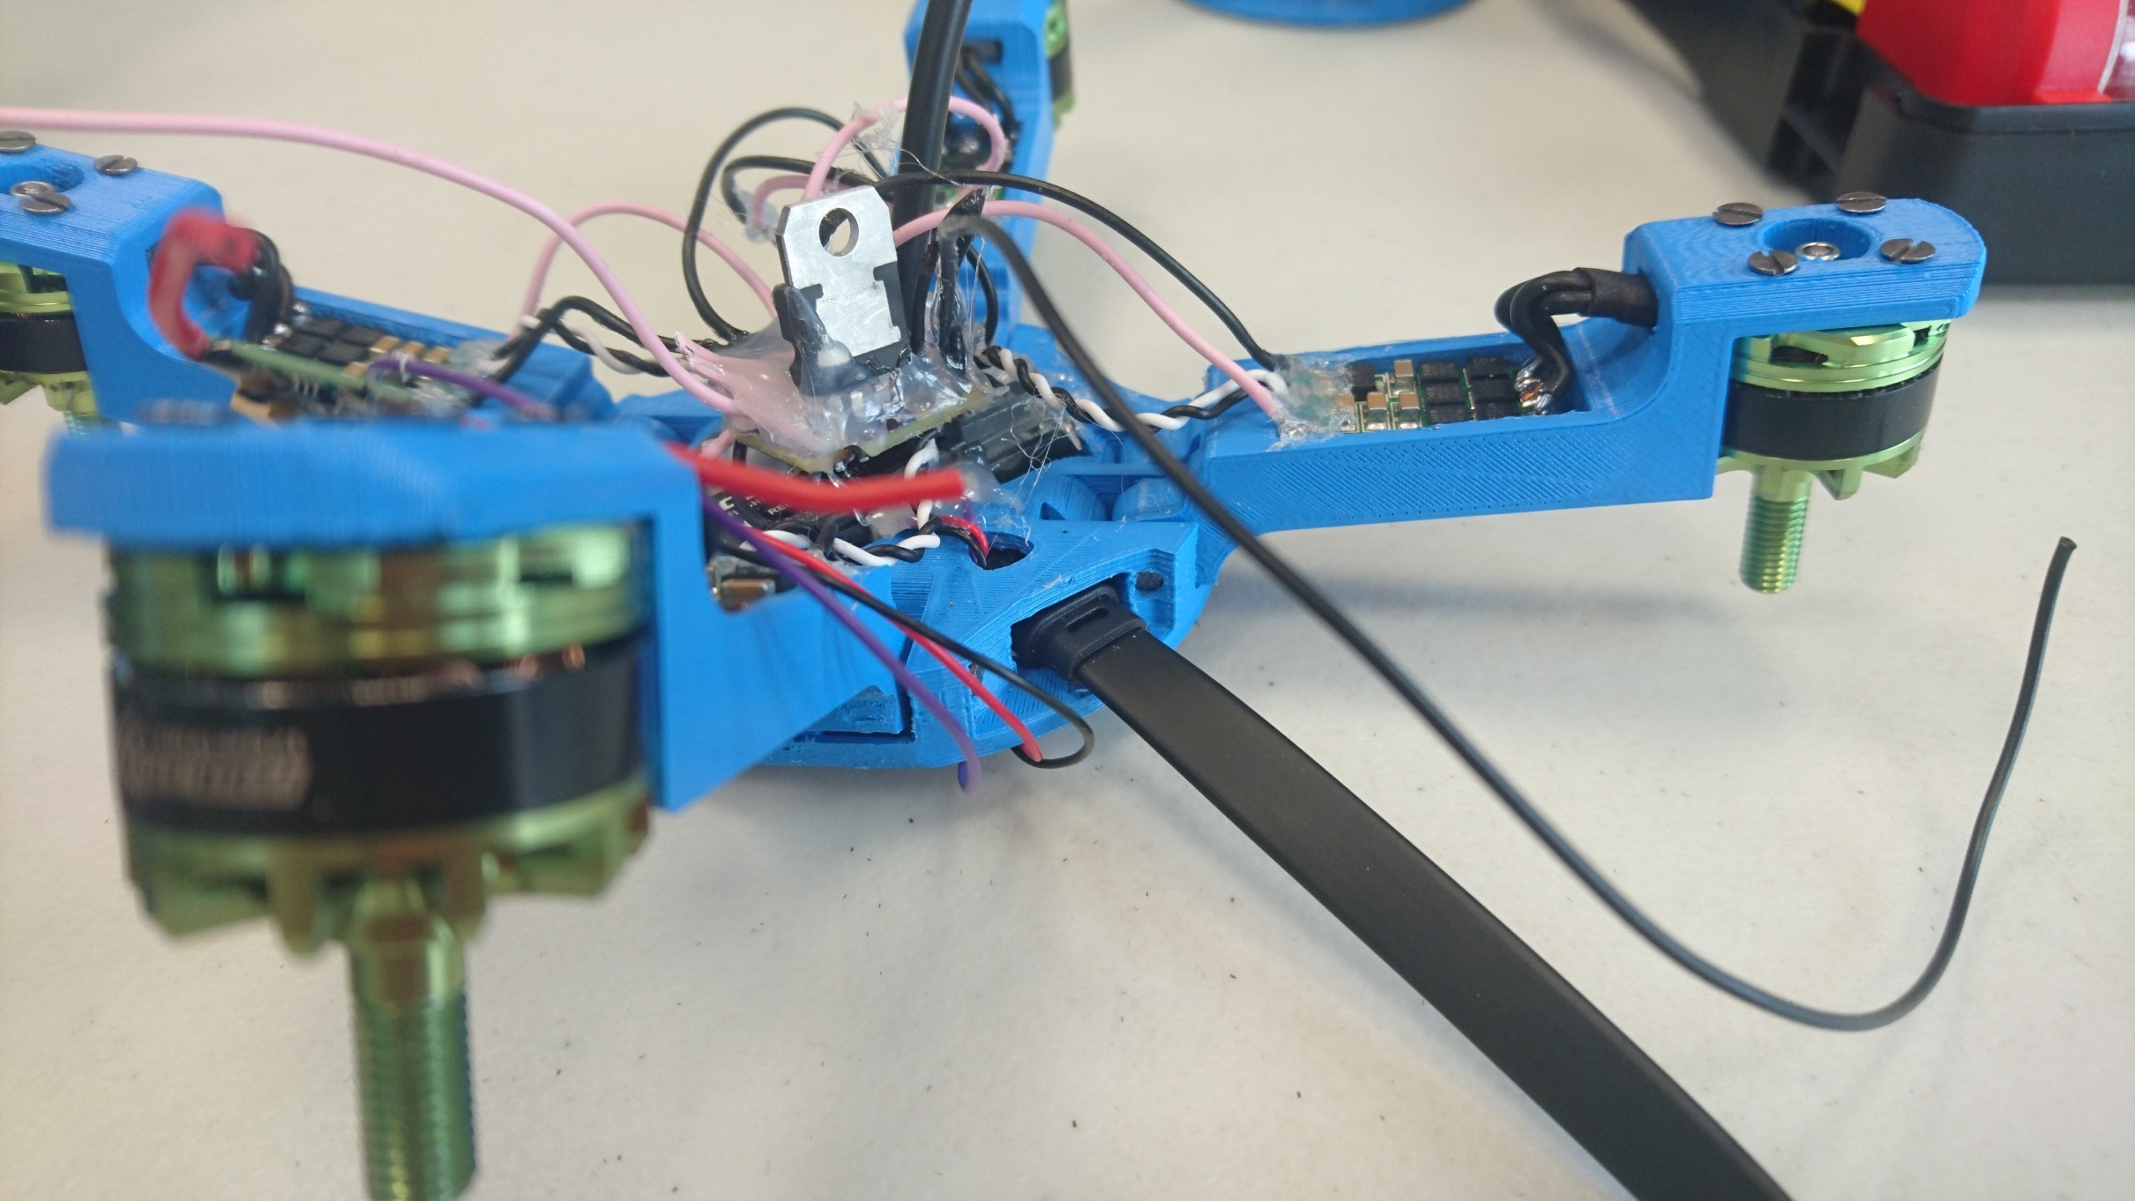

Slide 8
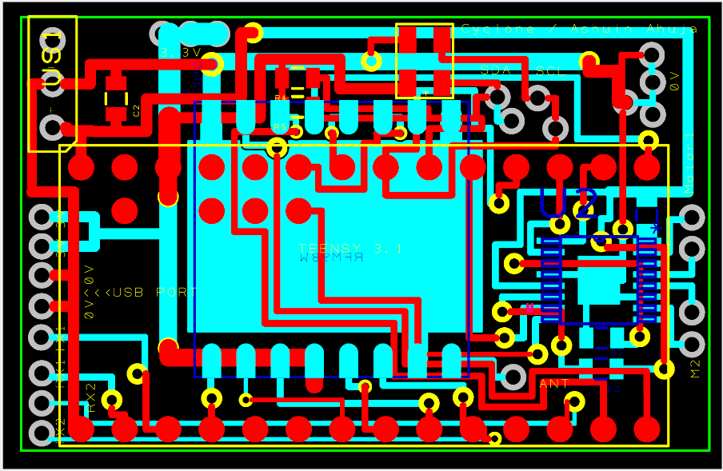
Electronics

Slide 9
Power Distribution
SENSOR SYSTEM
FLIGHT SYSTEM
CAMERA SYSTEM

Slide 10
SENSOR SYSTEM
MCU: Teensy 3.2
Pressure + Internal Temperature: Meas Spec 5637
Humidity + External Temperature: HygroChip271
IMU: SDLife Augmented LSMDS1 GPS: SiRF GP2106
SD Card: SparkFun OpenLog Transceiver: Hope RFM98W
FLIGHT SYSTEM
Control Board: OpenPilot CC3D
Motors: Turnigy Outrunner V2 (1704 – 1900KV)
ESCs: DYS BLHELI 16A Mini ESC
Receiver: Orange 6-Channel RX
CAMERA SYSTEM
FPV: TX-SkyZone 200
Camera: HobbyKing Mini CMOS520TVL
BATTERY
Zippy Compact 850mAh 3S 35C LiPo

Slide 11
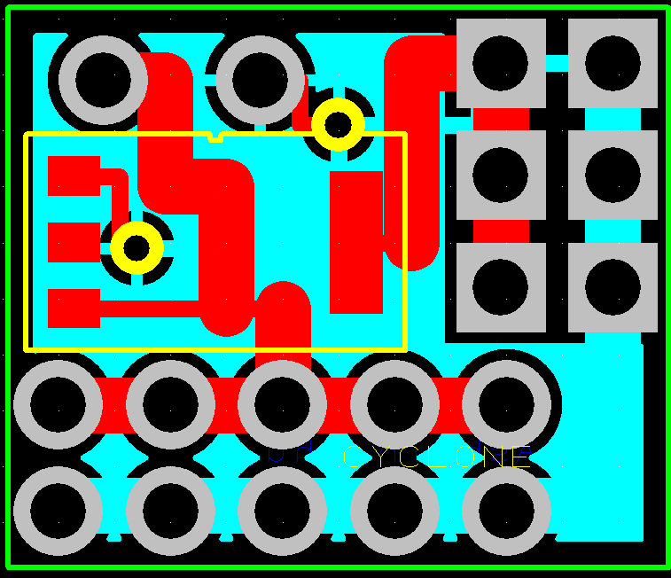
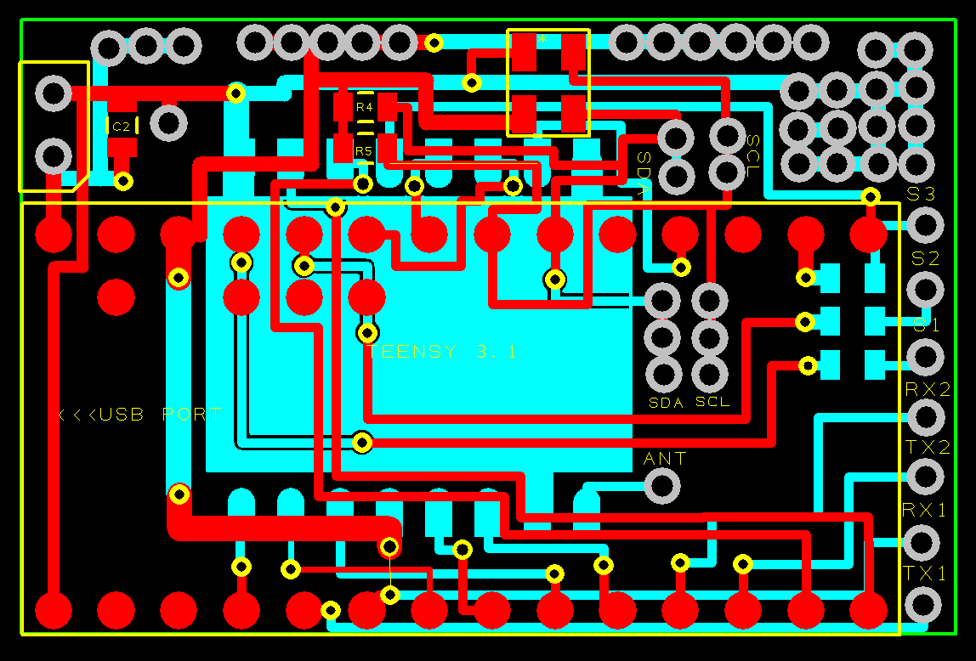
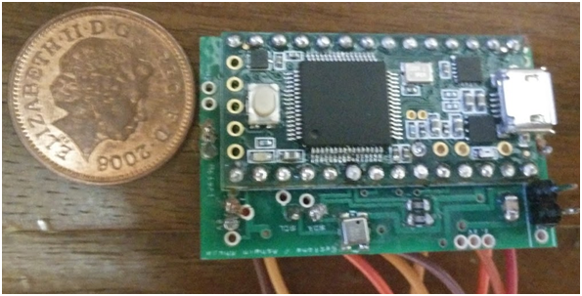
PCBs

Slide 12
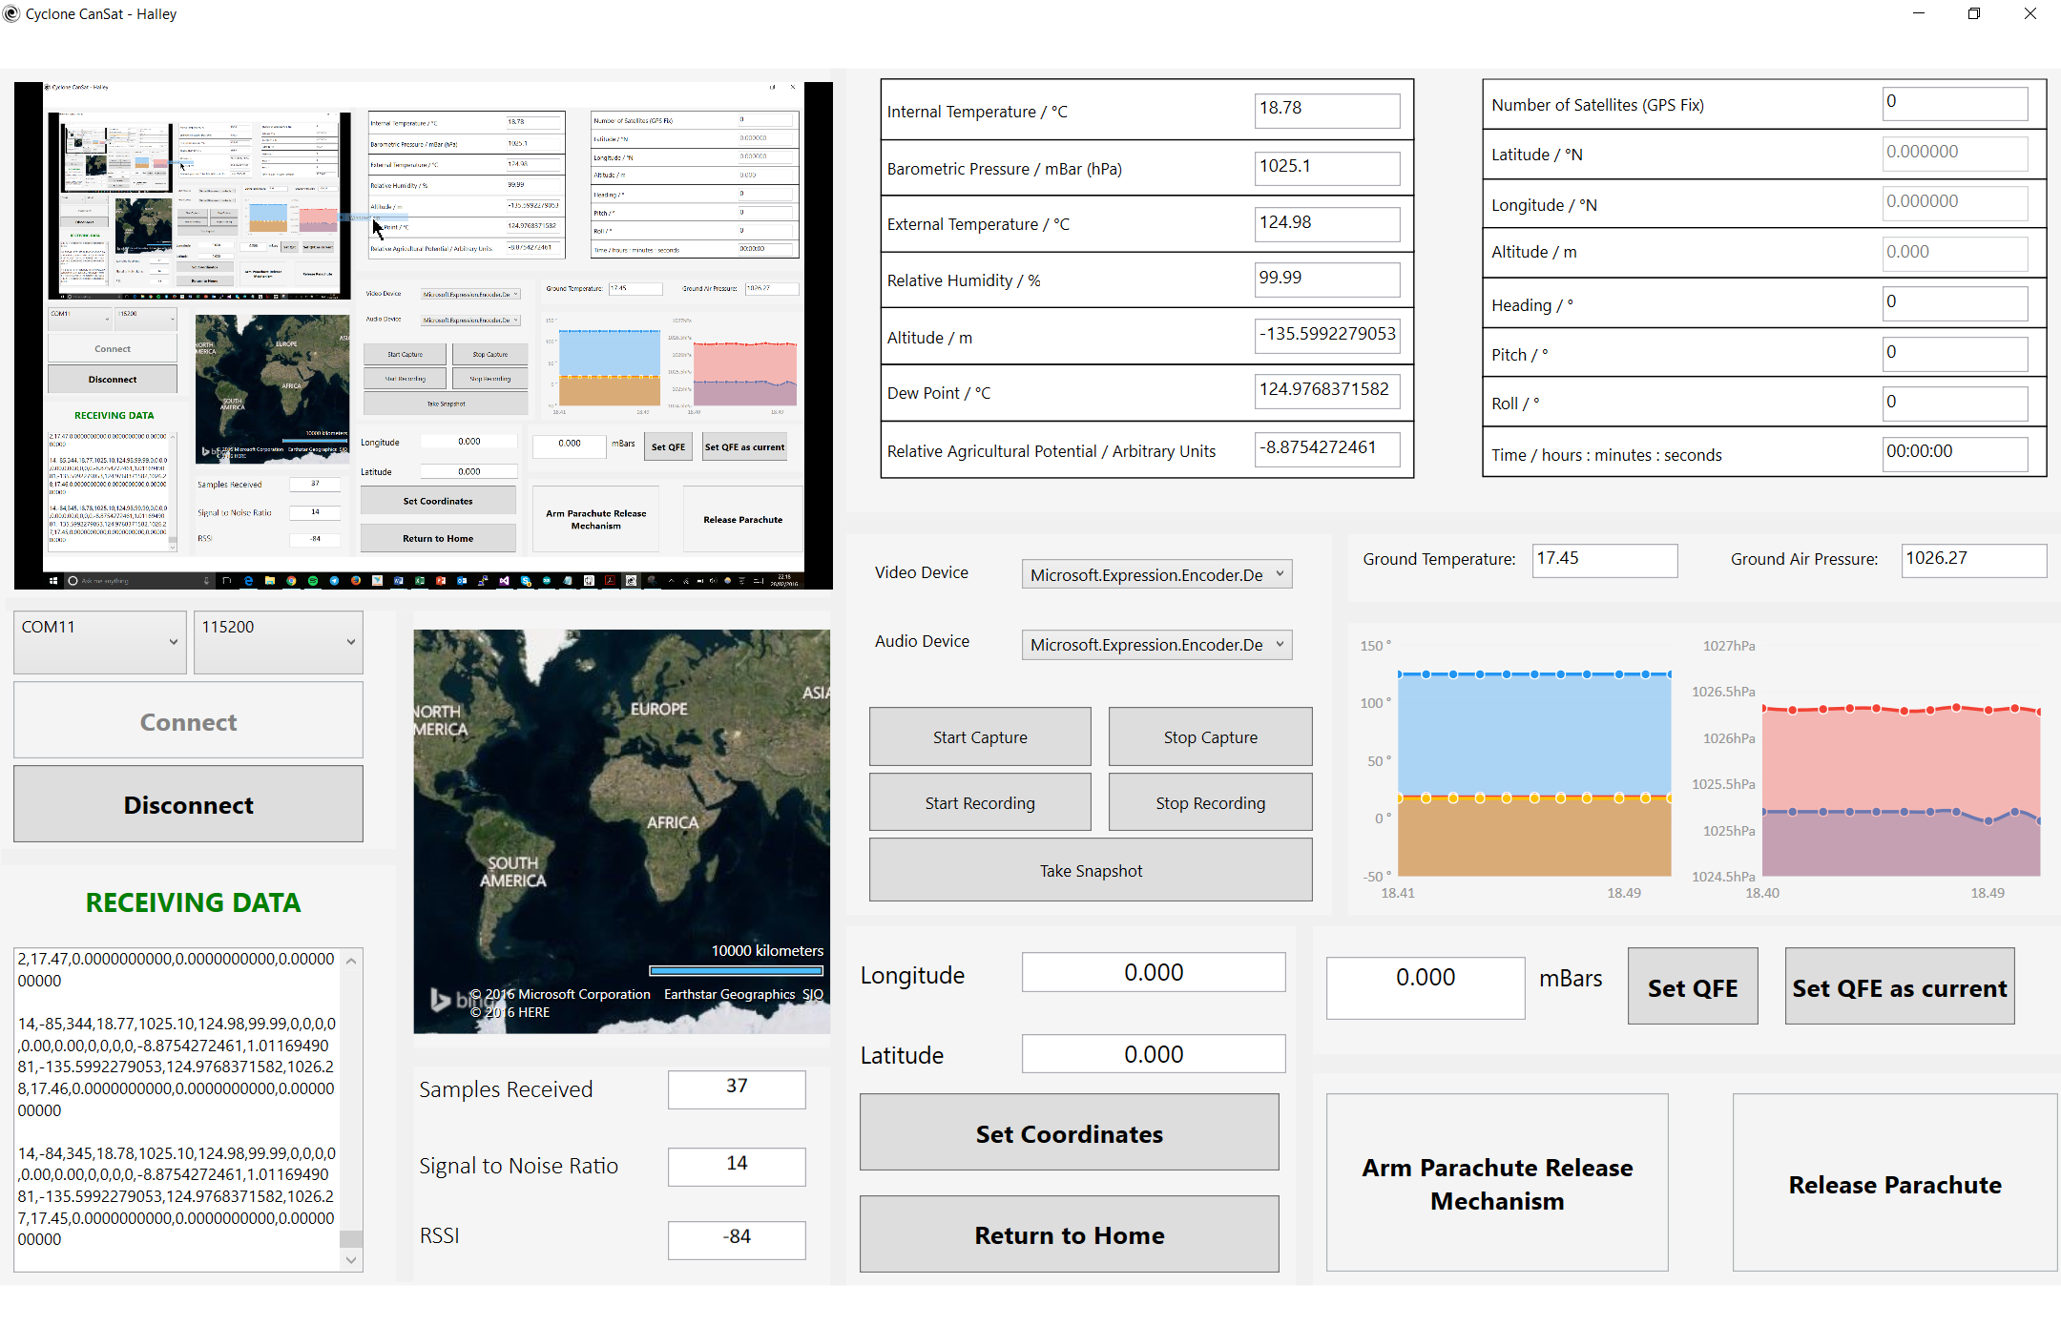
Software

Slide 13
Can Code
Void Setup()
Void Loop()
Include Libraries
Initialise sensors (using sensor library)
Read from sensors, using sensor library
Communications, using RFM98W library
Save data to SD Card

Slide 14
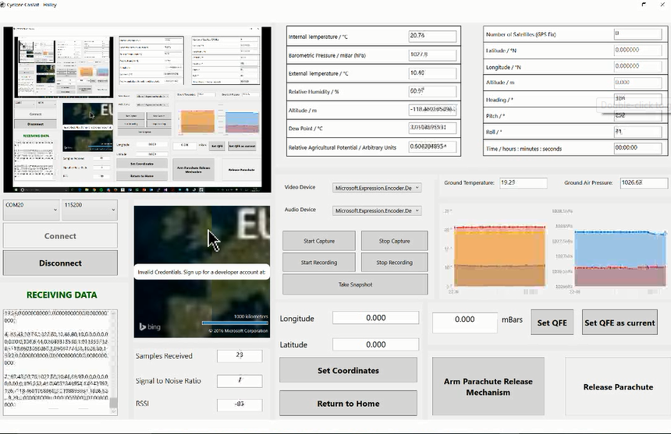

Slide 15
AUTONOMOUS MOTION
CAN
BASE STATION
FLIGHT CONTROL
CAN

Slide 16
Designing the Algorithm
Temperature
Humidity
Pressure
AGRICULTURAL VIABILITY

Slide 17
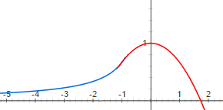
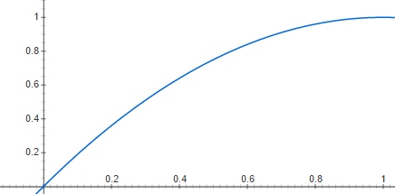
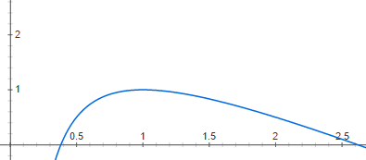
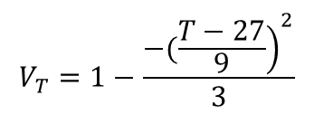
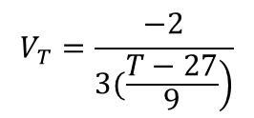
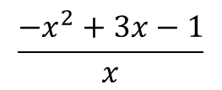
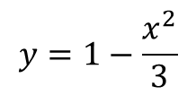
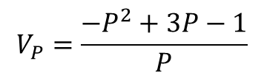
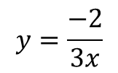
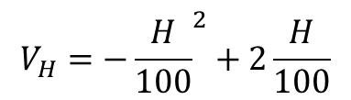
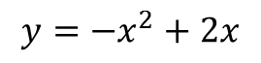
TEMPERATURE
Combination of two curves
Peaks at specific crop’s optimal temperature
Modelled to reflect effect of enzymatic activity within plant cells
$$y=\frac{−2}{3x}$$
$$y=1−\frac{x^{2}}{3}$$
$$V_{T}=\frac{−2}{\left.3(\frac{T−27}{9}\right)}$$
$$V_{T}=1−\frac{{\left.−(\frac{T−27}{9}\right)}^{2}}{3}$$
HUMIDITY
Uses relative humidity as a proxy for soil water content
$$V_{H}=−{\frac{H}{100}}^{2}+2\frac{H}{100}$$
$$y=−x^{2}+2x$$
PRESSURE
Assumption that pressure of 1 atm is optimal for Earth-based crops
Assumption that vacuum is more damaging than higher pressures
$$\frac{−x^{2}+3x−1}{x}$$
$$V_{P}=\frac{−P^{2}+3P−1}{P}$$

Slide 18
$$Agricultural Viability=V_{T}×V_{H}×V_{P}$$

Slide 19
Further Improvements

Slide 20
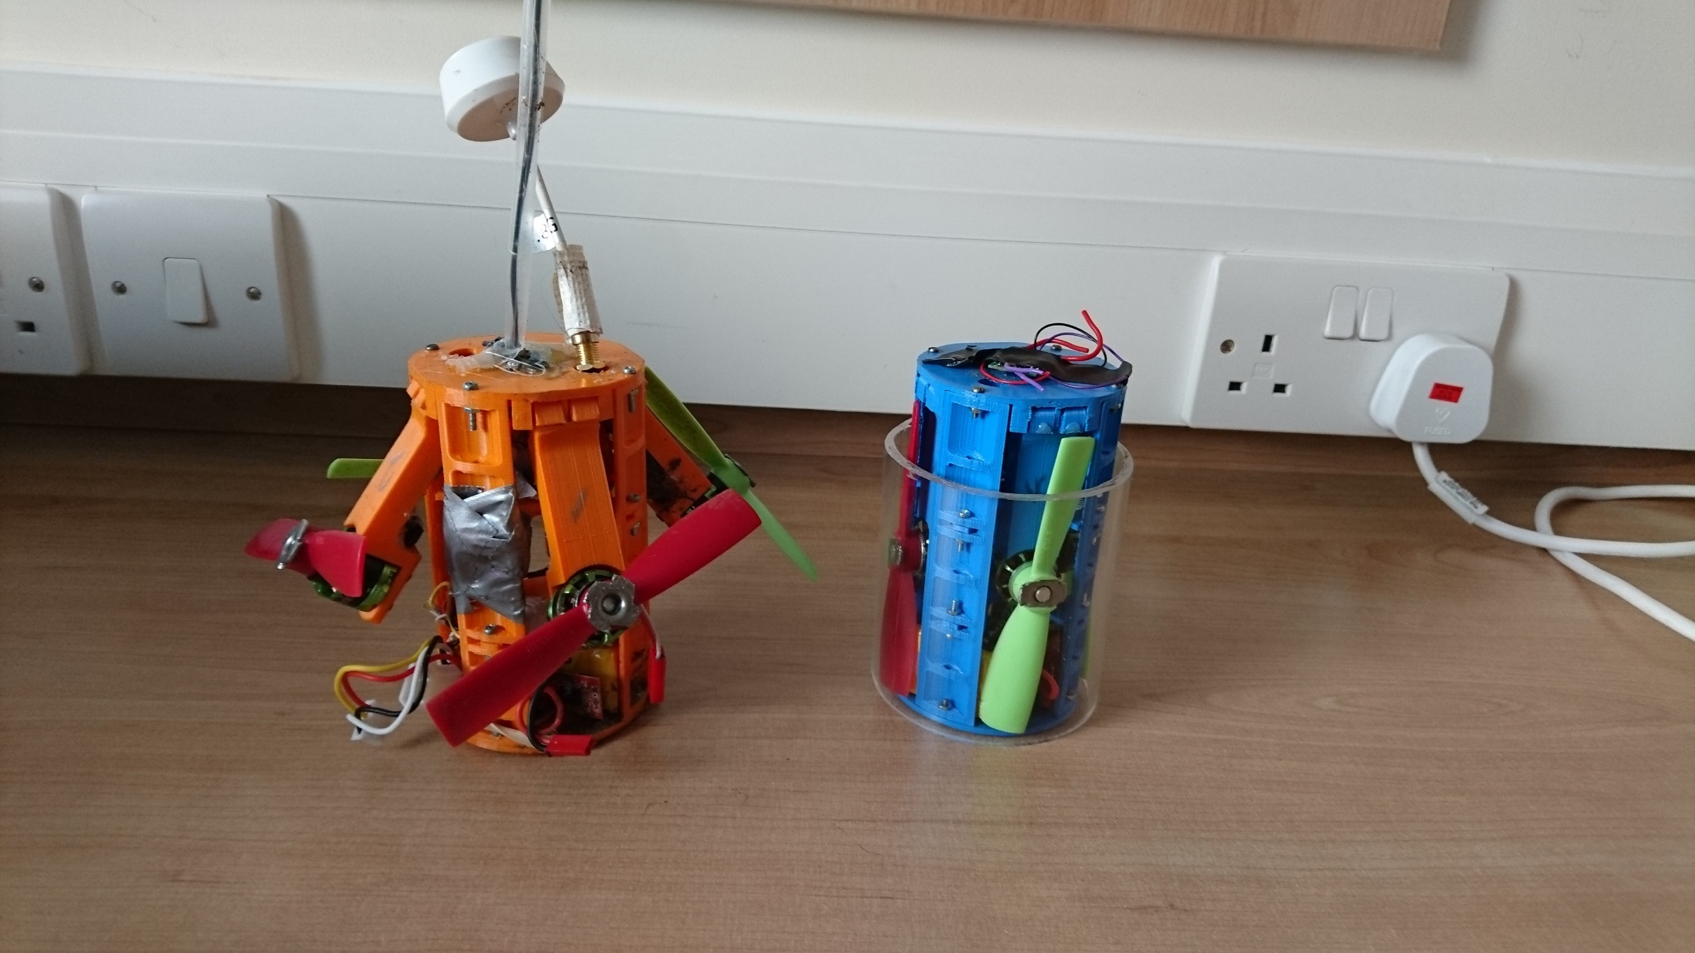

Slide 21
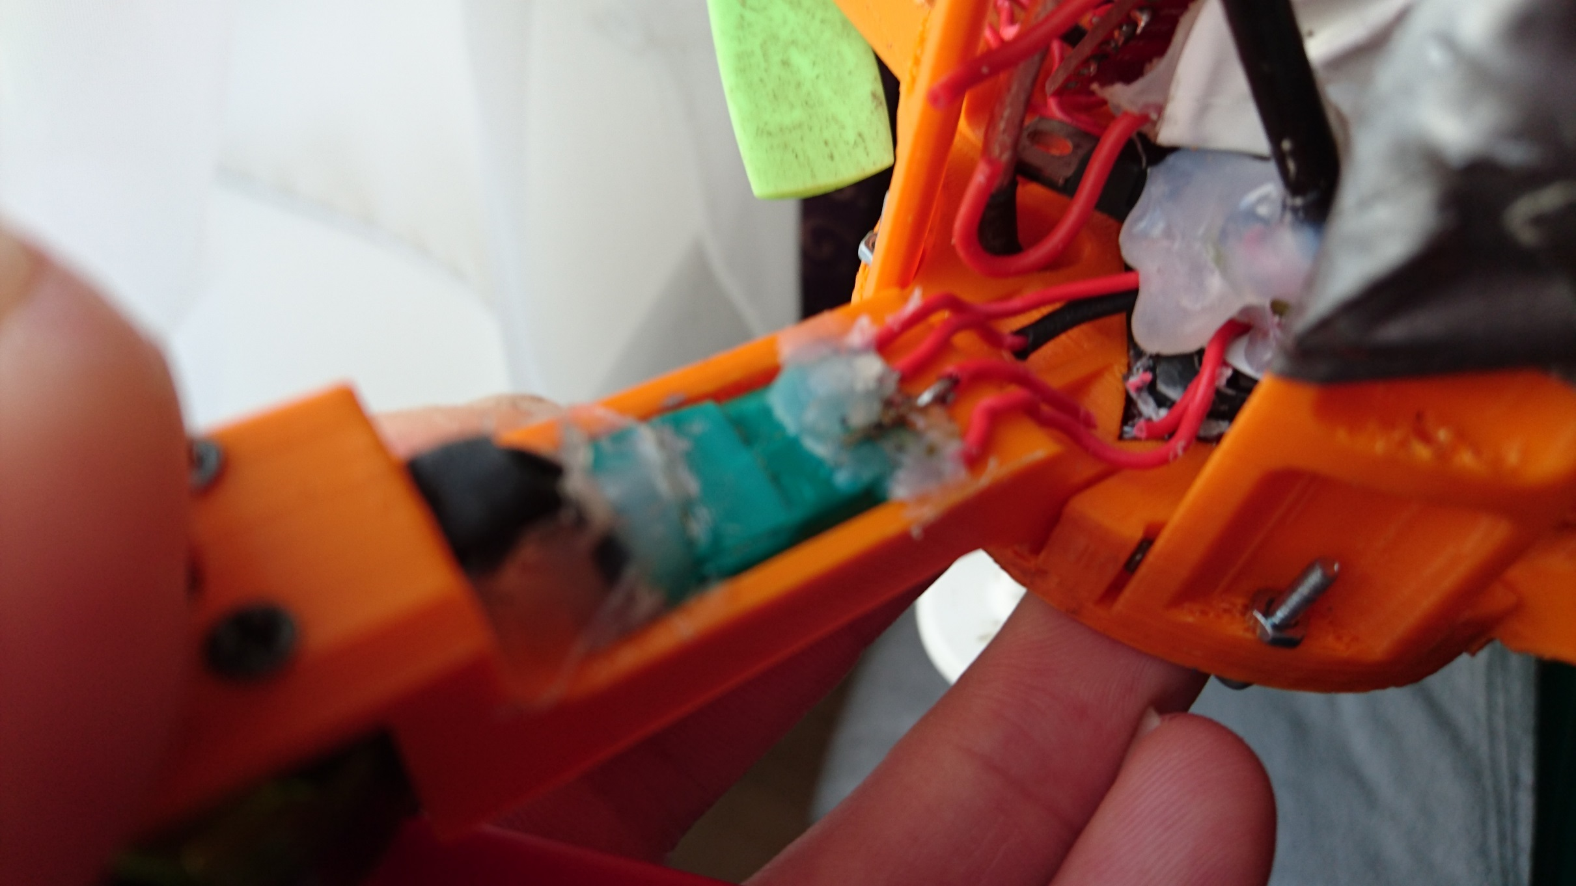

Slide 22
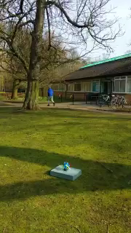

Slide 24
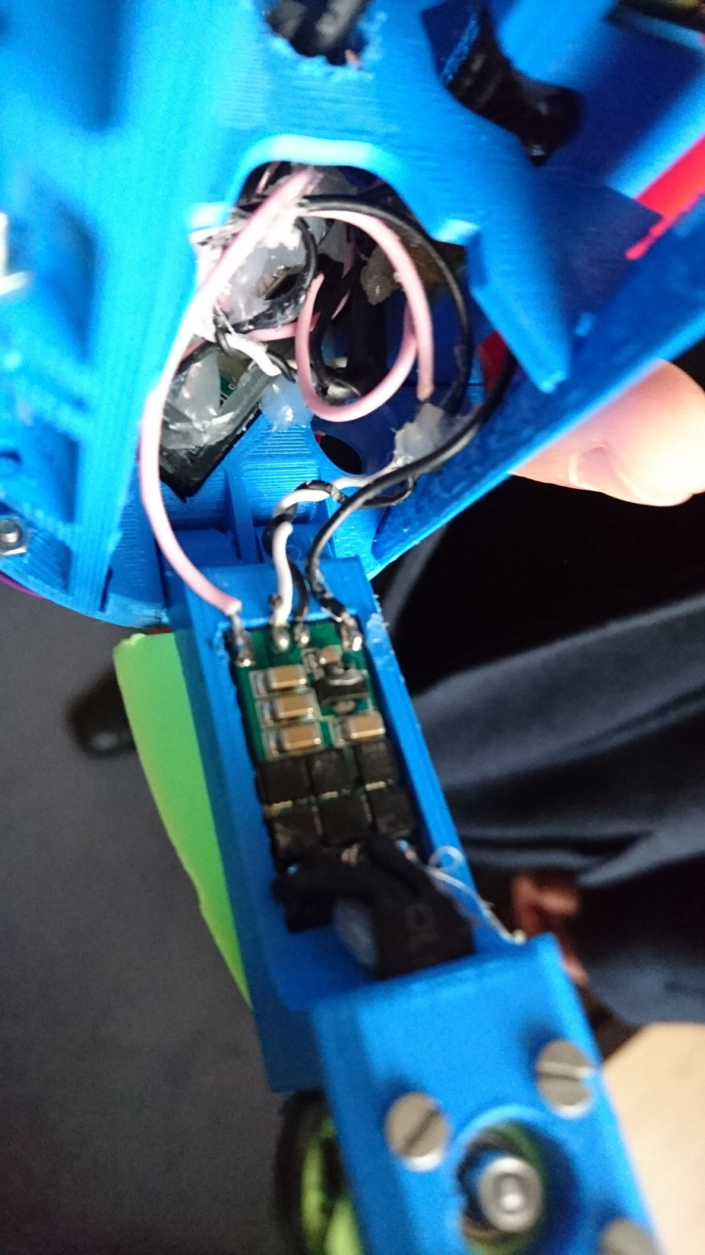

Slide 25
The Launch

Slide 26
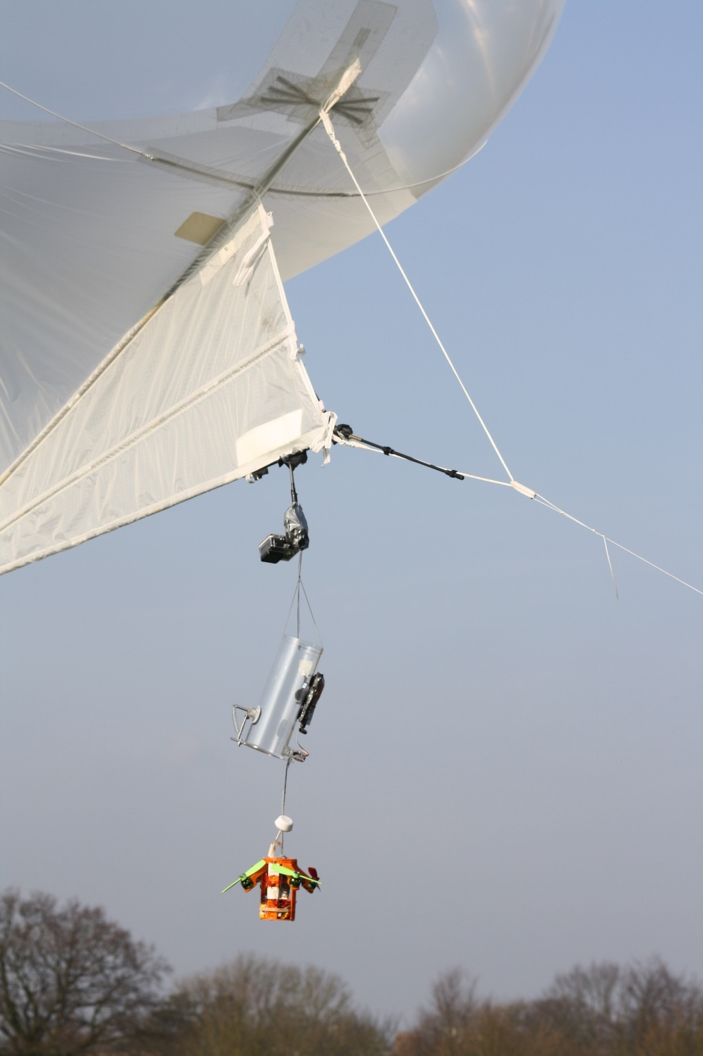
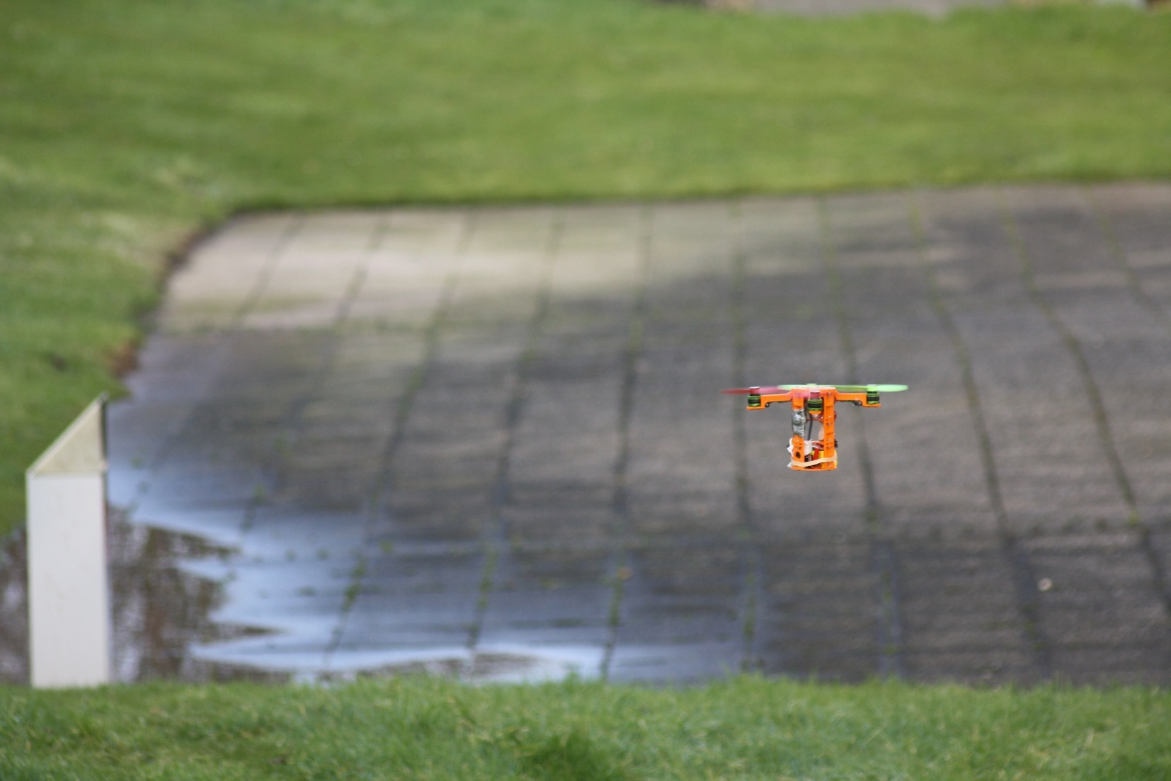

Slide 27
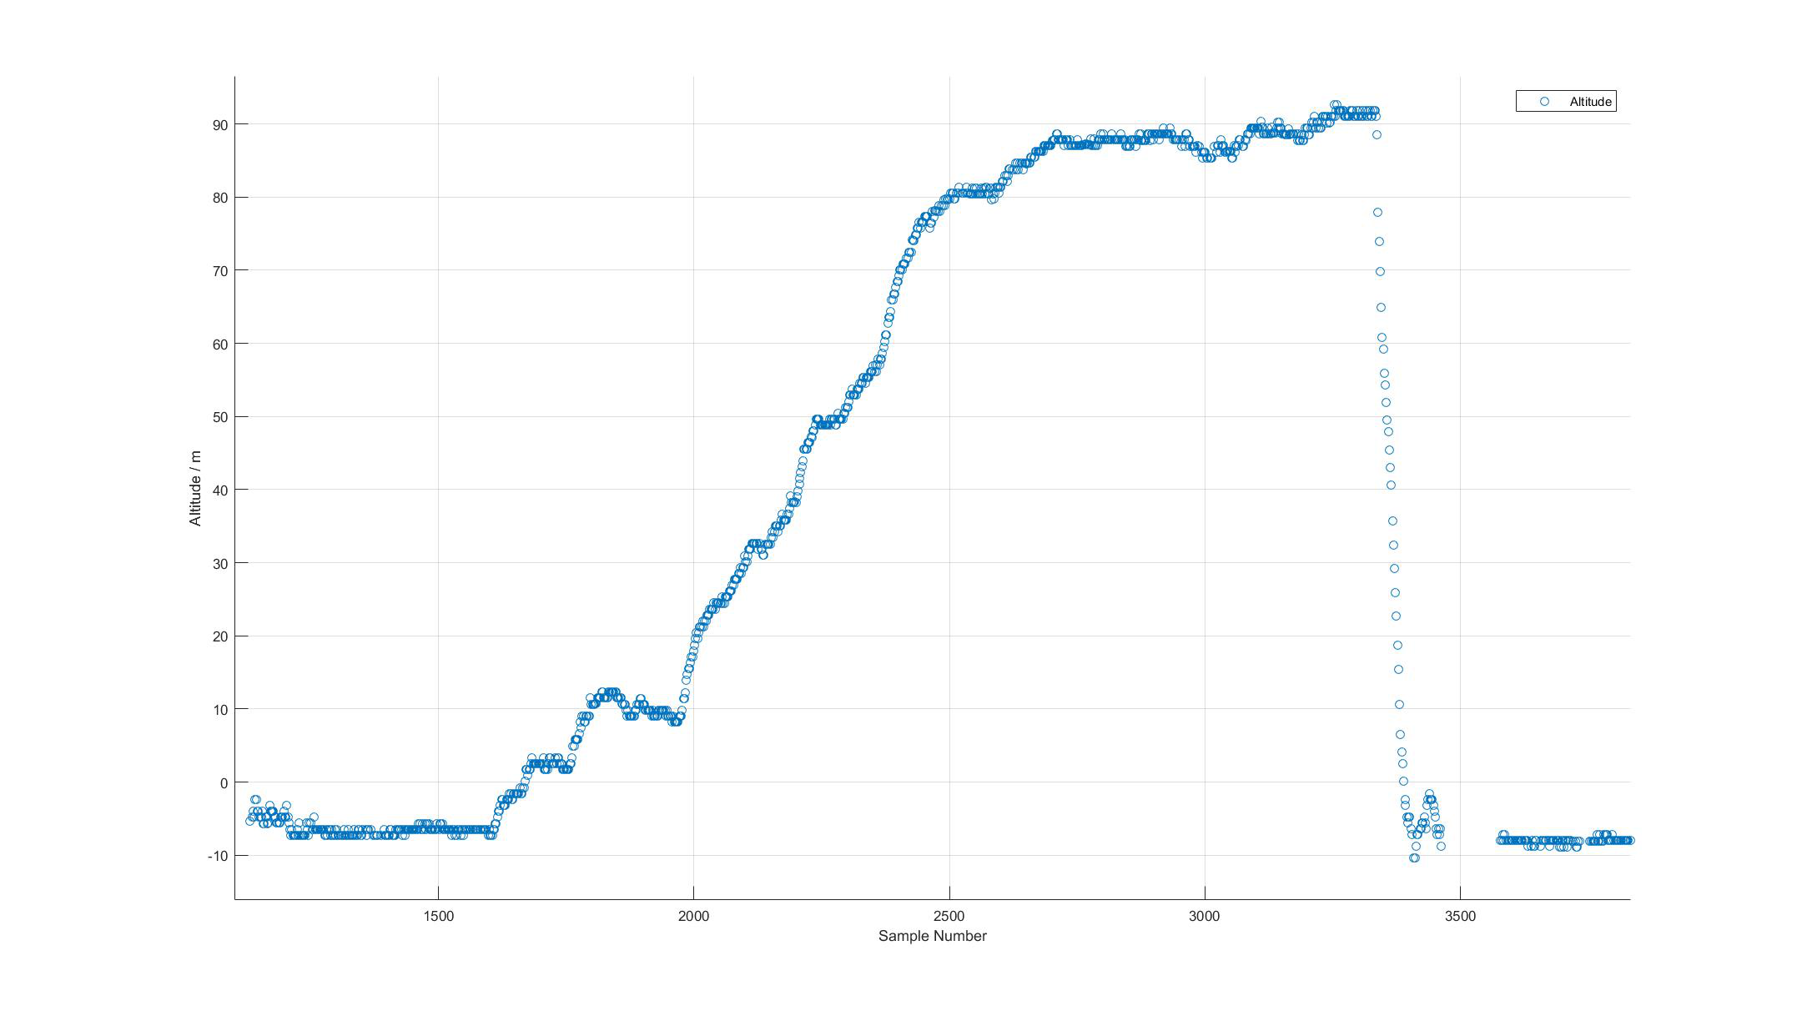

Slide 28
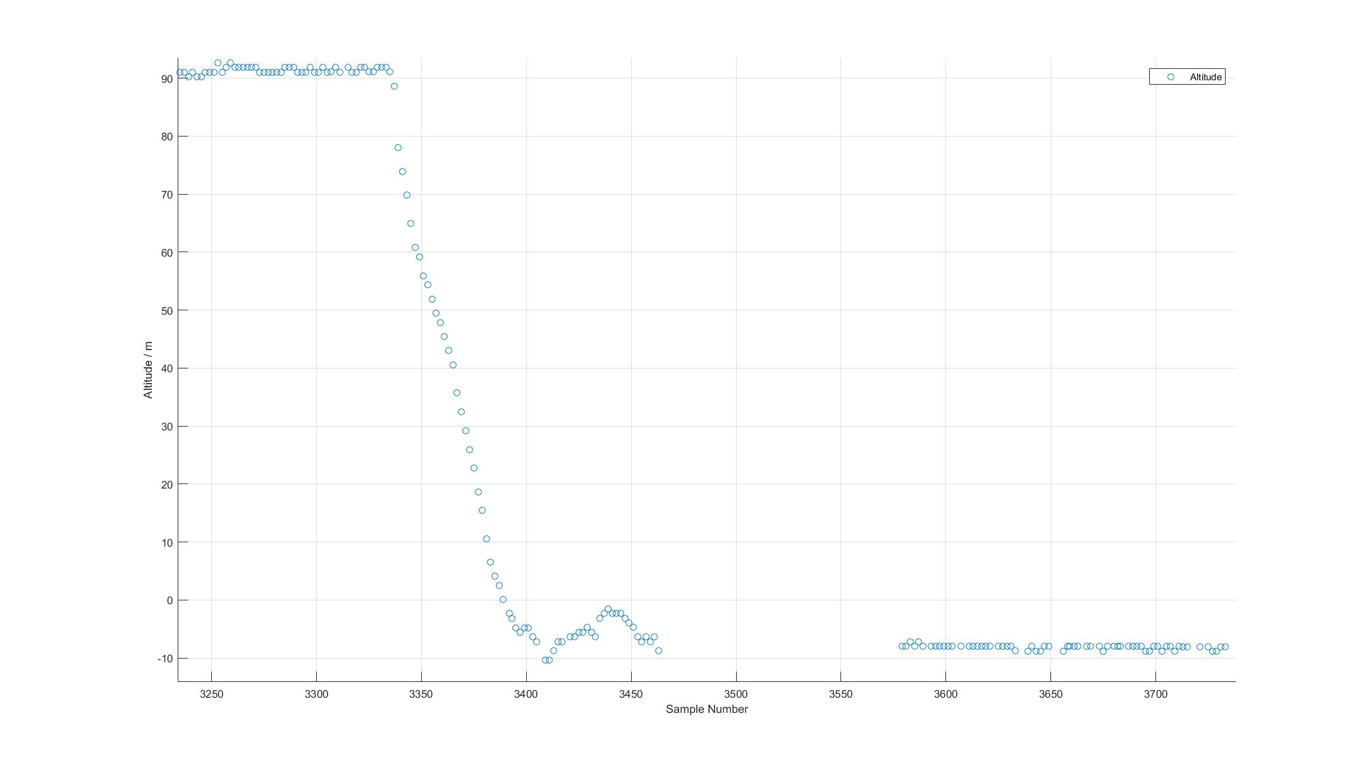
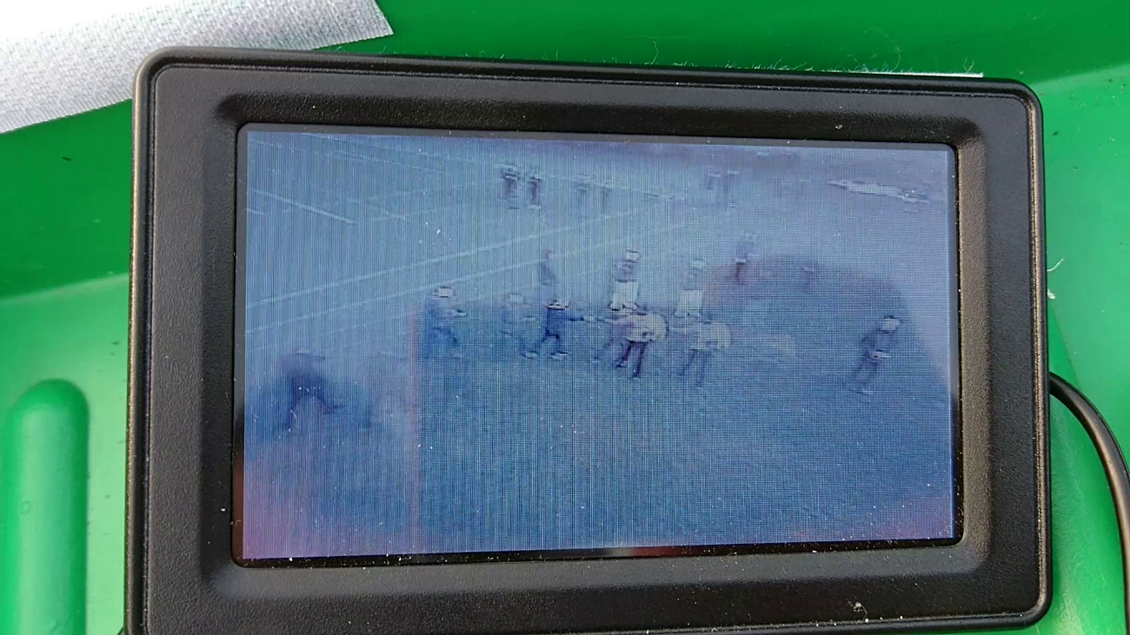

Slide 29
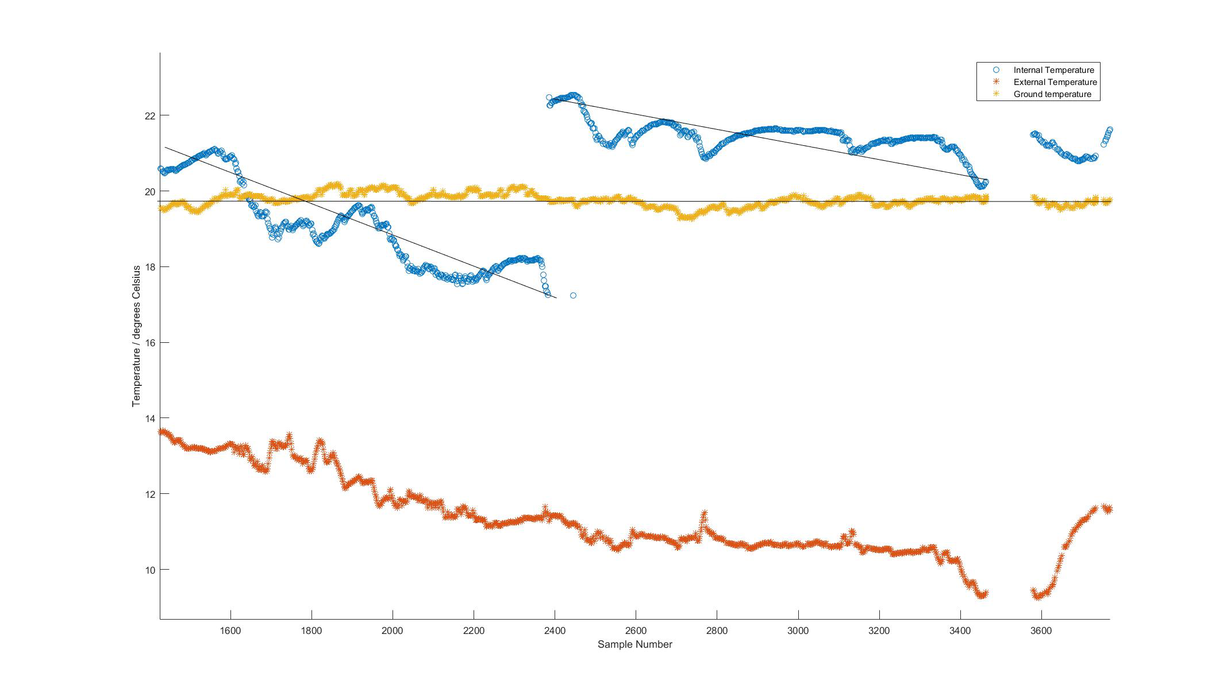
Data Analysis

Slide 30
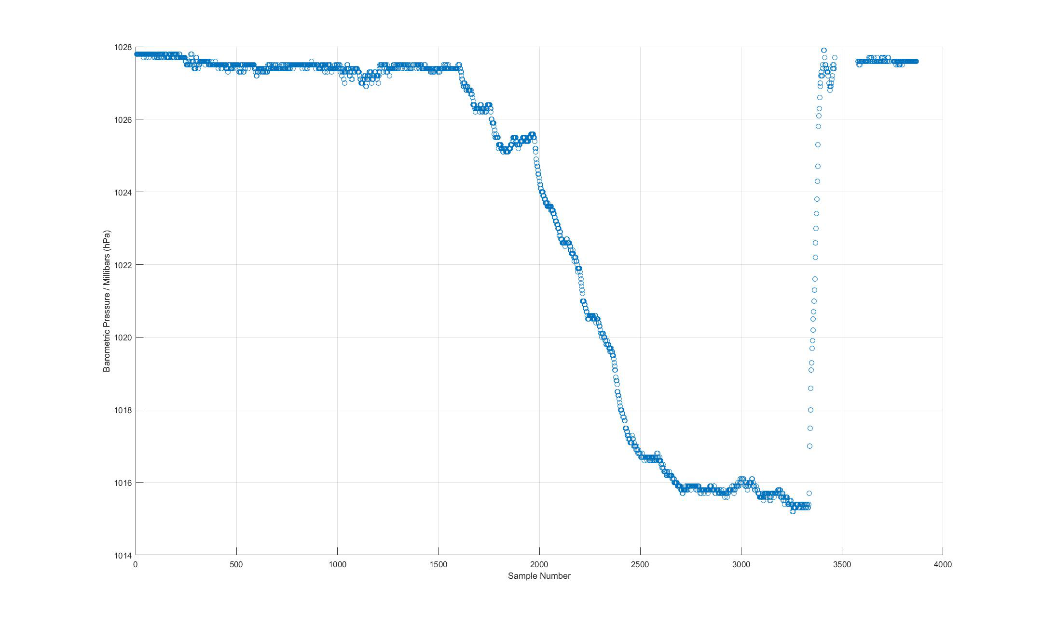
PRESSURE

Slide 31
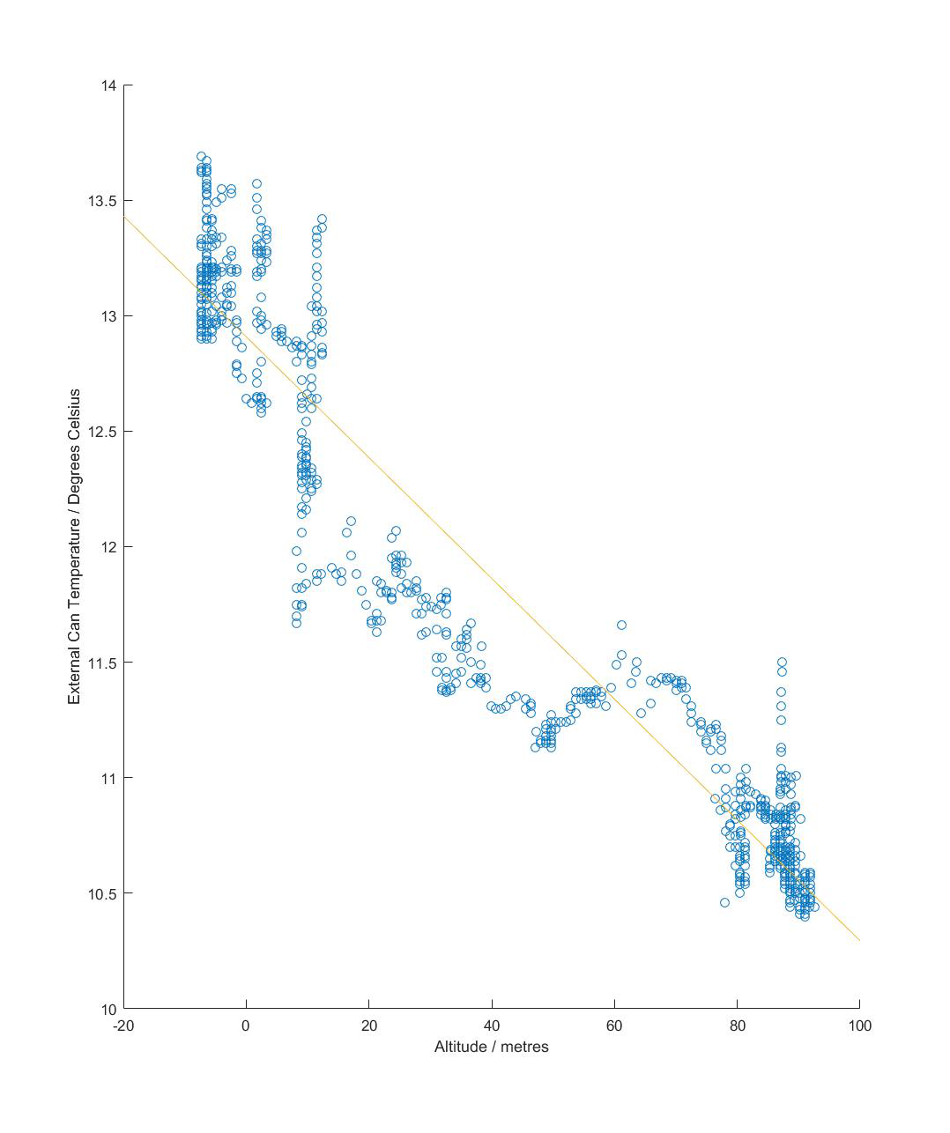
EXTERNAL TEMPERATURE & ALTITUDE

Slide 32
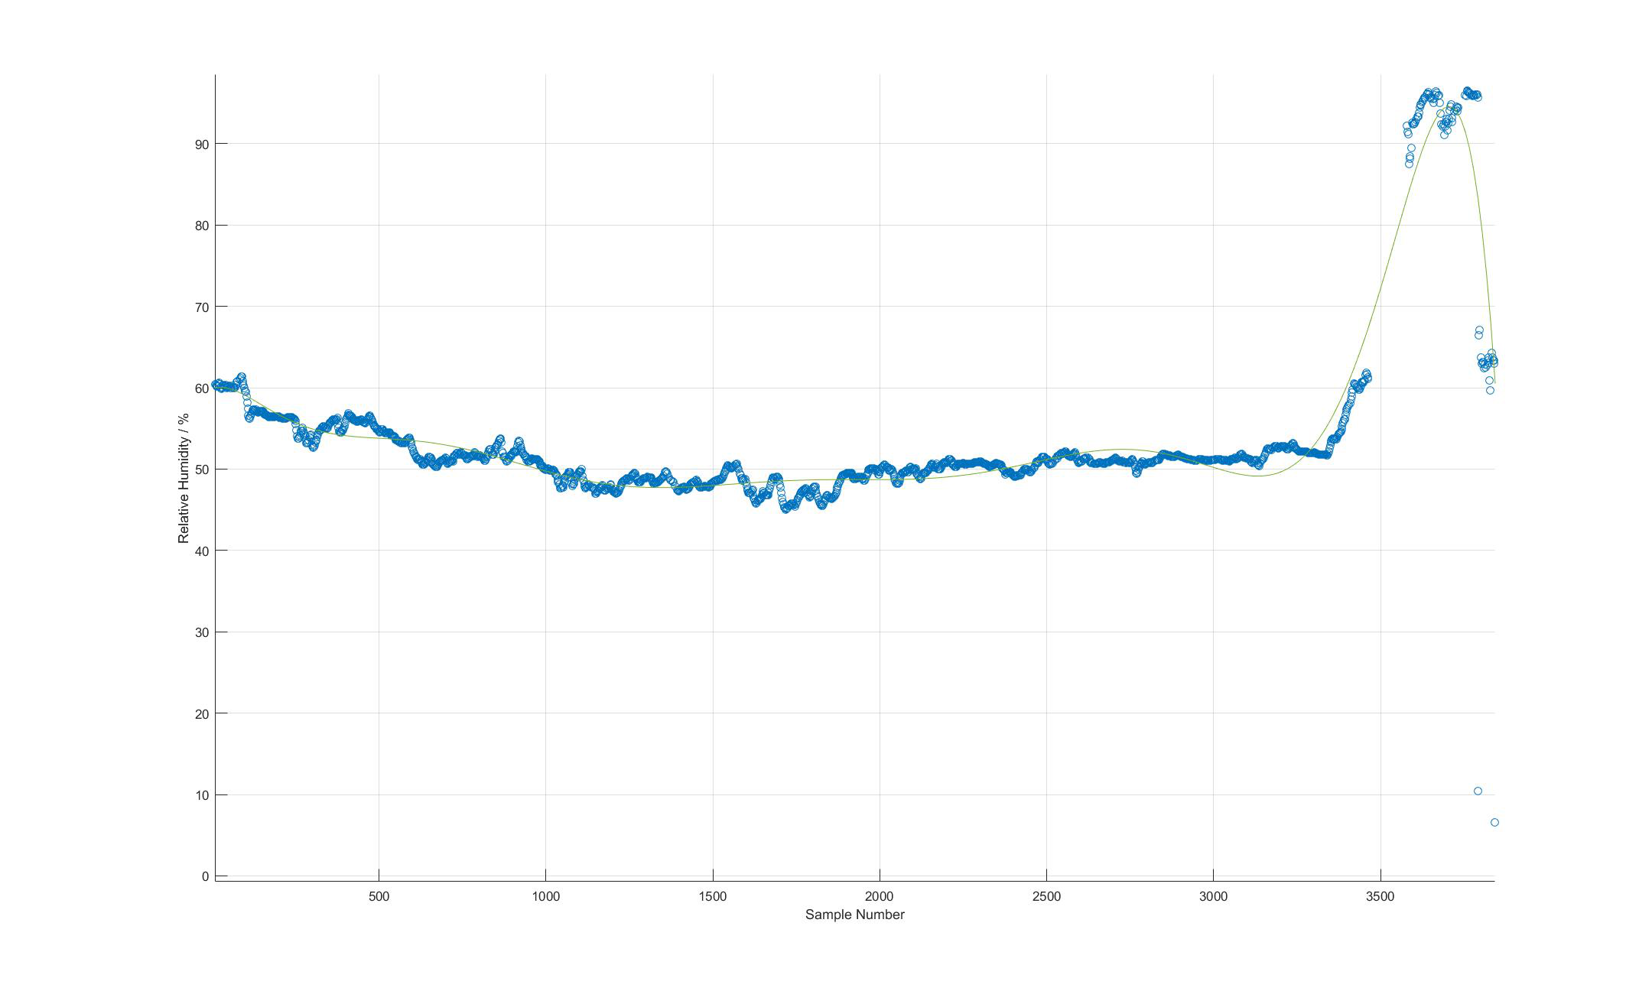
HUMIDITY

Slide 33
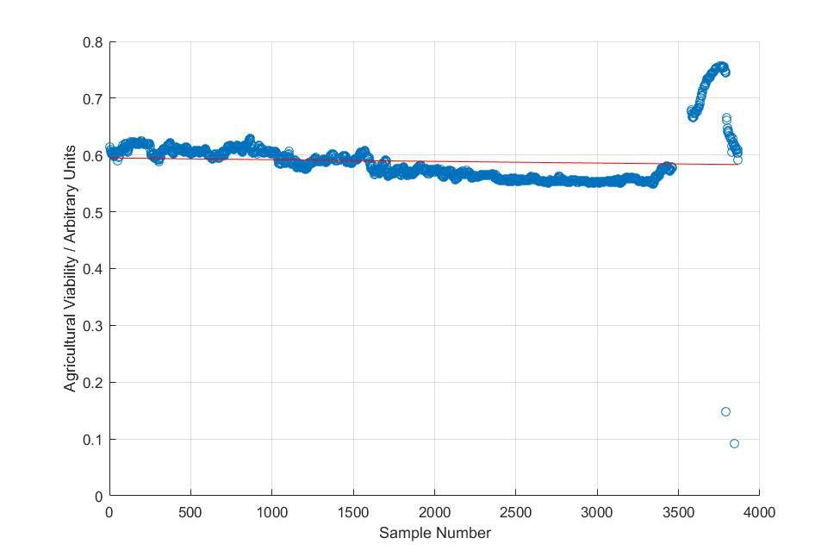
AGRICULTURAL VIABILITY

Slide 34
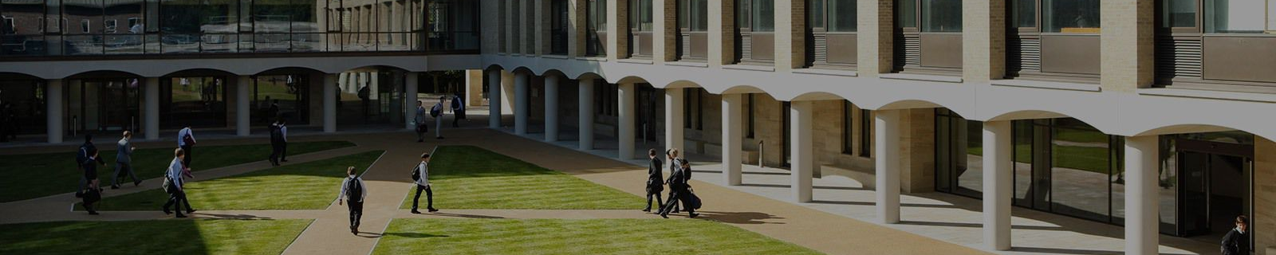
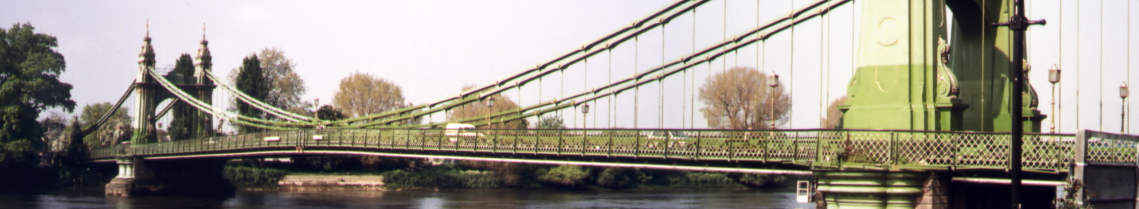

OUTREACH

Slide 35
school
The local community
The wider public

Slide 36
School
The Local Community
Talks at internal societies
Engineering / Physics Society
Project discussed at Societies Fair
School open day
Article in school magazine
Presentation at Colet Court
Talk to Surrey Explorer’s Club
SPS Summer Festival

Slide 37






The Wider Public
OUR WEBSITE
FACEBOOK
TWITTER
VIMEO
GITHUB
WORDPRESS
teamcycl.one
Cyclone CanSat
@spscyclone
Team Cyclone
github.com/
cyclonecansat
cyclonecansat. wordpress.com
Primary platform for learning about the team, linking to all other platforms
Sharing updates on the team’s progress
Brief updates of progress
Video sharing platform
Making source code, designs and plans available to the public
Blog posts by each team member

Slide 38

Funding
Sponsorships:
Newbury Electronics
HobbyKing
Arkwright Scholarships
School’s engineering budget
Cake sale

Slide 39
Conclusion

